Slide 1


Slide 2
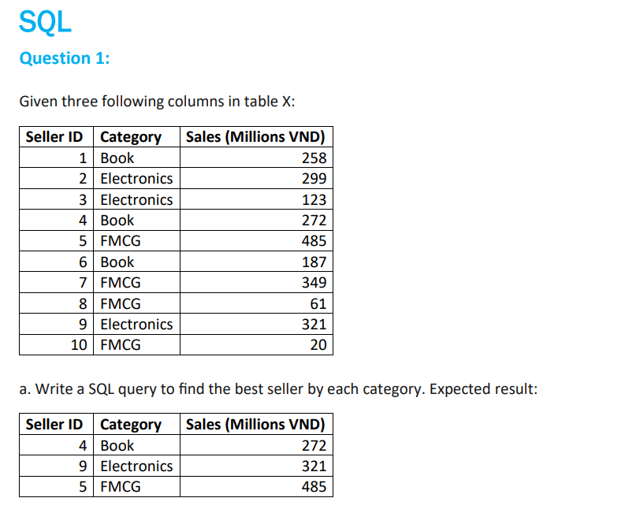

Slide 3
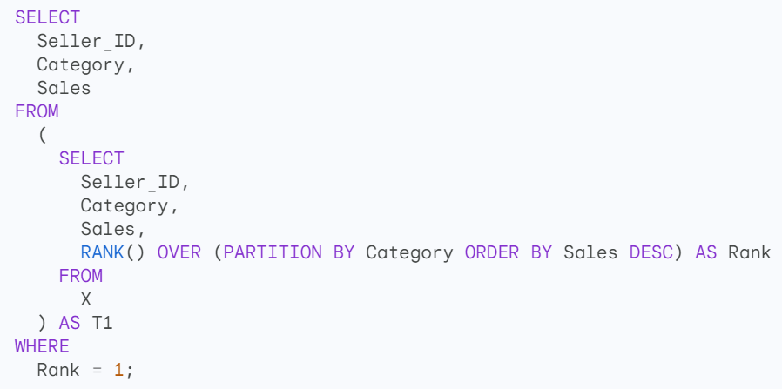
Solution

Slide 4
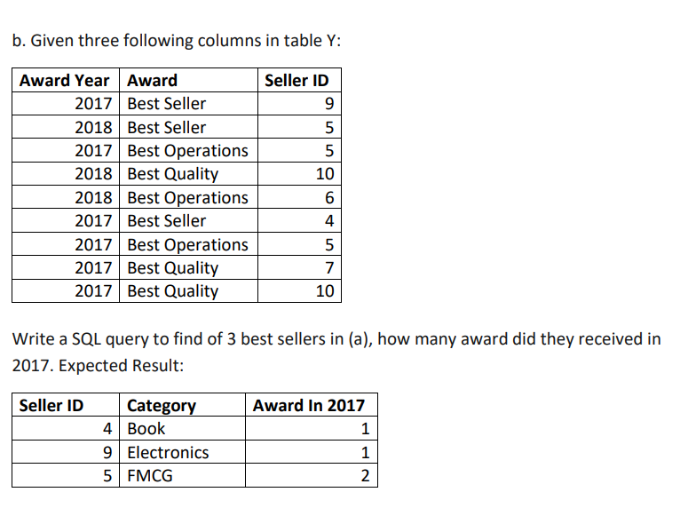

Slide 5
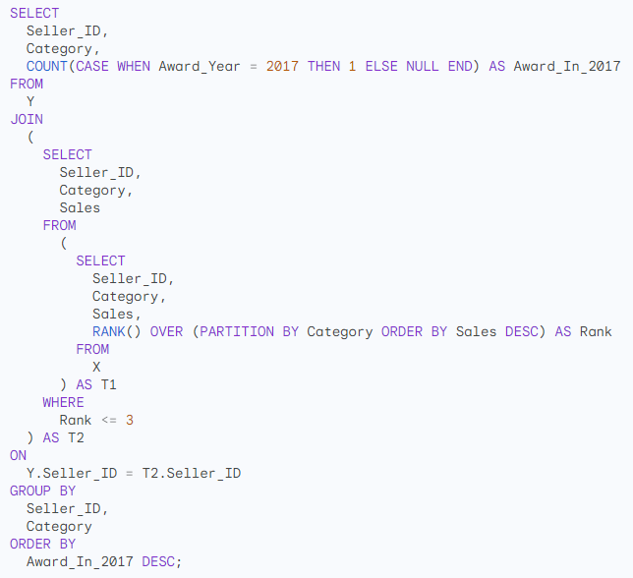
Solution

Slide 6
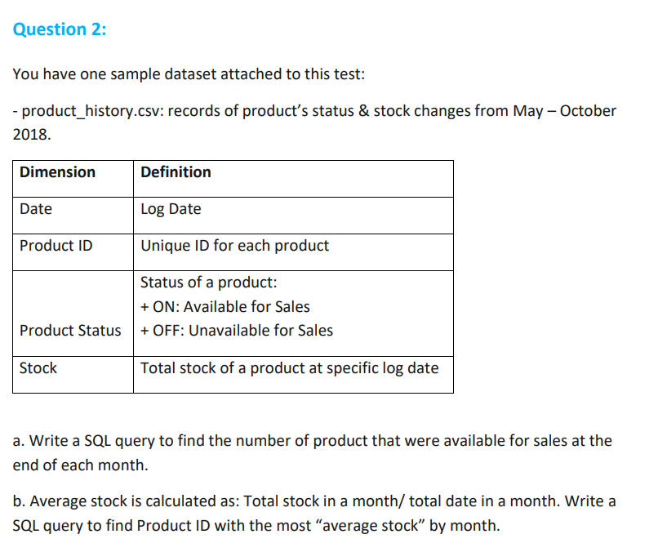

Slide 7
Solution

Slide 8
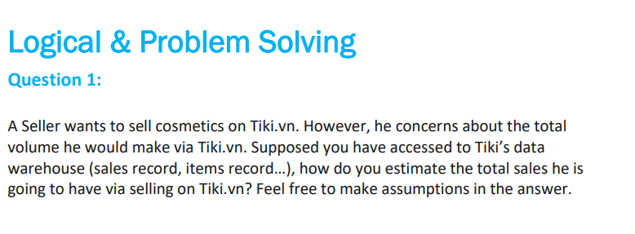

Slide 9
Solution
To estimate the total sales a Seller would make by selling cosmetics on Tiki.vn, I would do the following:
Analyze the historical sales data for cosmetics on Tiki.vn. This would give me an idea of the overall demand for cosmetics on the platform, as well as the sales performance of similar Sellers.
2. Consider the Seller's specific product offerings and pricing strategy. I would need to understand what types of cosmetics the Seller is planning to sell, as well as how their prices compare to those of other Sellers on Tiki.vn.
3. Make assumptions about the Seller's marketing and advertising efforts. I would need to consider how the Seller plans to promote their products to potential buyers on Tiki.vn.
Once I have gathered all of this information, I can use it to create a model to estimate the Seller's total sales.

Slide 10
Solution
Here is a simple example of a model that I could use:
Total Sales = (Historical Sales of Cosmetics on Tiki.vn) * (Seller's Product Quality and Pricing) * (Seller's Marketing Efforts)
I would need to adjust the weights of each factor in the model depending on the specific circumstances of the Seller. For example, if the Seller is selling high-quality cosmetics at competitive prices, I would give their product quality and pricing a higher weight in the model.
It is important to note that this is just a simple example. There are many other factors that could affect the Seller's total sales, such as the overall state of the economy, the competitive landscape, and the Seller's customer service.

Slide 11
Solution
Here are some additional assumptions that I would need to make in order to use this model:
The Seller's products are of good quality and are competitively priced.
The Seller will make a reasonable effort to market and advertise their products on Tiki.vn.
The overall state of the economy is stable.
The competitive landscape is relatively unchanged.
The Seller provides good customer service.
I would also need to monitor the Seller's actual sales performance over time and adjust the model accordingly.

Slide 12
Solution 2
Here's how you can estimate the total sales a seller might make selling cosmetics on Tiki.vn, assuming access to their data warehouse:
1. Identify Relevant Data:
Sales Data:
Historical sales data for cosmetic products on Tiki.vn (including total sales, average order value, and sales by category/brand).
Sales data for similar sellers in the cosmetics category (anonymized if necessary).
Product Data:
Information on cosmetic products already listed on Tiki.vn (category, brand, price, average rating, number of reviews).

Slide 13
2. Estimation Approaches:
A. Market-Based Approach:
Average Sales per Cosmetic Product: Calculate the average sales for cosmetic products on Tiki.vn based on historical data. Consider segmenting by subcategories (e.g., makeup, skincare) for a more refined estimate.
Market Share: Estimate the market share of cosmetics on Tiki.vn by analyzing total platform sales and the share of cosmetics within that category.
B. Seller-Based Approach (if data allows):
Similar Seller Performance: Analyze sales data of existing successful cosmetic sellers on Tiki.vn. Look for sellers with similar product lines, pricing strategies, and customer demographics.
Basket Analysis: Analyze customer purchase behavior for cosmetic products. See if customers who buy cosmetics also buy complementary products (e.g., makeup brushes with makeup). This can inform potential for bundled product offerings

Slide 14
3. Adjust for Seasonality and Trends:
Consider historical sales data to account for seasonal trends in cosmetic sales (e.g., higher sales during holidays).
Analyze current market trends in cosmetics (e.g., popular brands, product types) to adjust your estimate.
4. Assumptions and Limitations:
Data Quality: The accuracy of your estimate depends on the quality and completeness of the data available in the Tiki data warehouse.
Seller Performance: Estimating based on similar sellers assumes the new seller can replicate their success. This may not be guaranteed.

Slide 15
5. Refine and Iterate:
Your initial estimate is a starting point. As the seller accumulates sales data on Tiki.vn, you can refine your estimates by incorporating actual performance.
Example Calculation (using Market-Based Approach):
Average monthly sales for cosmetic products on Tiki.vn: $10,000
Estimated market share of cosmetics on Tiki.vn: 10%
Total estimated monthly sales platform-wide: $100,000
Assuming the seller captures 1% of the market share:
Estimated monthly sales for the new seller: $100,000 (total sales) * 10% (cosmetics market share) * 1% (seller market share) = $100
Remember: This is a simplified example. A more comprehensive analysis would involve further data exploration and potentially more sophisticated statistical techniques.

Slide 16
Additional Considerations:
Seller's Marketing Efforts: Factor in the seller's planned marketing efforts (promotions, advertising) that might influence sales.
Competition: Analyze the competitive landscape for specific cosmetic products the seller plans to offer.
By leveraging data from Tiki's data warehouse and applying these approaches, you can provide the seller with a reasonable estimate of their potential sales volume. However, it's important to communicate the limitations of the estimate and the influence of various factors that can impact actual sales performance.

Slide 17
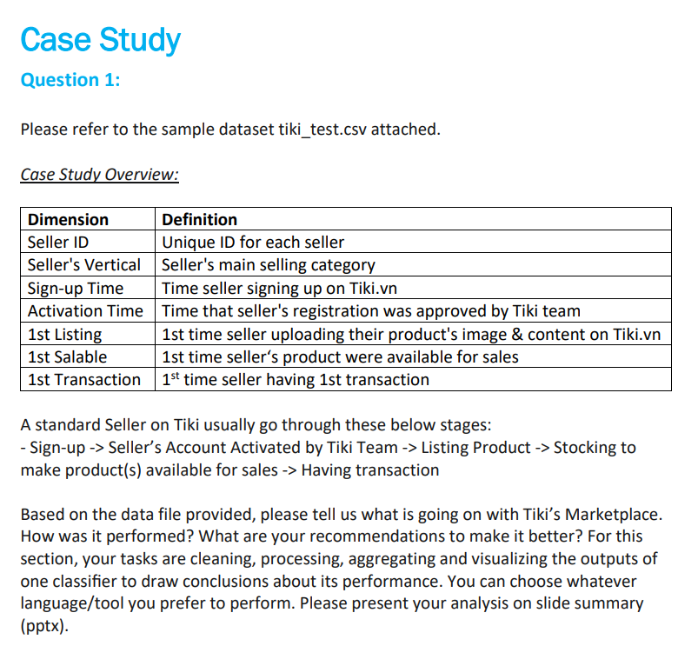

Slide 18
Solution
This would involve removing any rows with missing values, converting the date and time columns to datetime objects, and calculating the following metrics:
Days to Activation: The number of days between the seller signing up and their account being activated by Tiki.
Days to 1st Listing: The number of days between the seller's account being activated and their first product being listed.
Days to 1st Salable: The number of days between the seller's first product being listed and becoming available for sales.
Days to 1st Transaction: The number of days between the seller's first product becoming available for sales and their first transaction.
I would then aggregate the data by Seller's Vertical and calculate the average and standard deviation for each of the metrics described above.

Slide 19
Solution
Problem: Build a classifier to predict whether or not a seller will have their first transaction within 7 days of their first product becoming available for sales.
Idea: I would use a variety of features to train the classifier, including the metrics that I calculated in the previous step, as well as other features such as the seller's location, the number of products they have listed, and the category of products they are selling.
Evaluating the Classifier
Visualizing the Results
For example, I could create a bar chart to show the average number of days to first transaction for each seller vertical, or I could create a confusion matrix to show how well the classifier is able to predict whether or not a seller will have their first transaction within 7 days of their first product becoming available for sales.

Slide 20
Solution
Recommendations
Based on the results of the classifier, I would make the following recommendations to Tiki:
Focus on helping sellers to go from first product to first transaction more quickly.
Target seller verticals that are taking longer to go from first product to first transaction.
Use the classifier to identify sellers who are at risk of not having their first transaction within 7 days of their first product becoming available for sales.

